Slide 1
Competitive Solar Incentive (CSI) Program
Stakeholder Meeting #4
June 6, 2022

Slide 2
Welcome
This is the fourth public stakeholder meeting for the design of the CSI Program under
Docket # QO21101186
Competitive Solar Incentive (“CSI”) Program
pursuant to P.L. 2021, C.169
In addition, two stakeholder meetings were held on the Solar Siting Straw Proposal under the same docket

Slide 3
Covered in this meeting
This meeting will focus on the following part of the CSI Straw Proposal released on
April 26, 2022:
Section IV.D - Auction price result
Section IV.E - SREC-II payment structure

Slide 4
Webinar Instruction Page
All attendees will be automatically muted
Questions? Please use the “Q &A” function in Zoom
We will address clarifying questions at the end of each section
Please note that the “Chat” function in Zoom is not available for this meeting
This meeting is being recorded. A copy of the recording and slides will be made available on the BPU website:
https://www.nj.gov/bpu/newsroom/public/

Slide 5
Disclaimer
This presentation is provided for informational purposes only and should not be taken to represent the views of the New Jersey Board of Public Utilities, its Commissioners, or the State of New Jersey. Please be aware that any information presented is subject to change if there are changes to New Jersey statutes, rules, or policies.
All viewers are responsible for ensuring that they rely only on current legal authority regarding the matters covered in the presentation.

Slide 6
Written Stakeholder Comment Guidelines
The deadline for comments on the CSI Straw is 5:00 p.m. ET on Monday, June 20, 2022.
Please submit comments directly to Docket No. QO21101186, using the “Post Comments” button on the Board’s Public Document Search tool.
Comments are considered “public documents” for purposes of the State’s Open Public Records Act and any confidential information should be submitted in accordance with the procedures set forth in N.J.A.C. 14:1-12.3.
Written comments may also be submitted to:
    Carmen D. Diaz
    Acting Secretary of the Board
    44 South Clinton Avenue, 1st Floor
    Post Office Box 350
    Trenton, NJ 08625-0350
    Phone: 609-292-1599
    Email: board.secretary@bpu.nj.gov

Slide 7
CSI STAKEHOLDER MEETING #4
June 6, 2022

Slide 8
Today’s Agenda
Topic
Importance
Auction price result
SREC-II payment structure
Compare Pay-As-Bid vs Single Clearing Price as mechanism for determining SREC-II awards
Compare indexed SREC-II and fixed SREC-II structures,
Identify the risks and rewards of both approaches
Notes:
AB: the agenda also has IV.D: auction price result -> this must be included as a separate section, even if it is only a couple of slides
Formatting: IV.E (rather than IV E)
KD – Agree. The first item listed is “Section IV.D - Auction price result” on the Stakeholder Notice. That segment needs to be covered in this presentation.
“Straw Proposal” rather than “proposal” – KD - Agree
“SREC-II” not “SREC-II” – KD – Agree
KD – Suggest making “Compare indexed SREC-II and fixed SERC-II structures as the first bullet, and making the balance of that sentence a second bullet. It will make the topics easier to read that way.

Slide 9
Auction Result
Pay-As-Bid vs Single Clearing Price

Slide 10
Pay-As-Bid vs Single Clearing Price
Based on
Wide adoption in other state procurements,
The avoidance of paying more than bids,
The interaction with the tranche system, allowing for potentially more “preferred siting” projects to get awarded, and
An acceptable administrative burden
the recommendation is to use the pay-as-bid approach in awarding SREC-IIs

Slide 11
SREC-II Payment Structure
Indexed vs Fixed

Slide 12
Discussion: SREC-II Payment Structure
Fixed vs Indexed SREC-IIs
Impacts on WACC for financing projects
Risk / Benefit to New Jersey ratepayers
Other
Contract term length
SREC-II payments approach – via administrative rules vs contracts

Slide 13
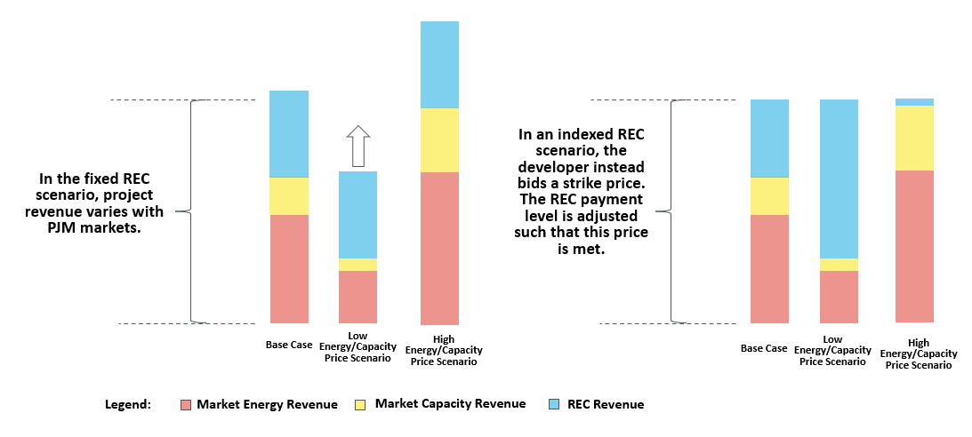
Two Approaches: Fixed and Indexed RECs
Indexed REC structure provides steady revenue to developers, while the Fixed REC structure provides certainty around ratepayer costs of environmental attributes.

Slide 14
Impact on Developer risk
Indexed REC Structure reduces market risk for developers, but production and basis risk remain
Fixed REC Contracts | Indexed REC Contracts
Capacity Market Price Risk
Production Risk
Production Risk
Wholesale Energy Market Price Risk
Basis Risk
Basis Risk
Note: with Indexed RECs, any risk NOT borne by developers, is borne by ratepayers

Slide 15
Daymark Analysis on Fixed and Indexed SREC-IIs
Daymark conducted analysis to understand two things:
Impact on SREC-II cost due to developers’ revenue uncertainty risk
Impact on ratepayer cost due to risks associated with variable REC payment structure
Indexed SREC-II structure used in analysis:
Assumes developer bids an all-in Strike Price
SREC-II price paid = Strike Price - Monthly average on-peak Zonal Day Ahead LBMPs $/MWh + Capacity prices $/MWh

Slide 16
Daymark Analysis Conclusions
The WACC adjusted for forecasted cashflows was slightly lower for developers in the Indexed scenario
The result of stochastic Monte-Carlo performed showed savings for ratepayers in the vast majority of cases
About 20% of the cases showed the total indexed SREC-II contract cost to ratepayers being higher than an alternative fixed SREC-II contract
The analysis does not account for potential changes in market structure, which increases longer-term ratepayer risk in the case of Indexed RECs

Slide 17
Impact on the CSI Program could be $21 Million Savings Annually
Note: Numbers are for calculation purposes only and do not indicate expectations for bid prices

Slide 18
Current Proposal
Board Staff and Daymark seek additional comments on Indexed SREC-II or Fixed SREC-II format
15-year SREC-II term
Administrative awards, rather than individual contracts

Slide 19
Thank you
Carrie Gilbert
(207) 347-3145 | cgilbert@daymarkea.com
Louisa Lund
(617) 778-2590 | llund@daymarkea.com
DAYMARK ENERGY ADVISORS
Our team brings deep knowledge and an integrated view of energy infrastructure, regulation, and markets to help our clients make well-informed business, capital investment, and policy decisions in the face of transformative change to achieve decarbonization.
DaymarkEA.com

Slide 20
Stakeholder Comments
Please be respectful of other speakers.
We will call on speakers in order. If your name is not showing in the list of participants (only a phone number), please raise your hand when it is your turn to speak.
Phone controls for participants
    The following commands can be entered via DTMF tones using your phone's dial pad while in a Zoom meeting:
    *6 - Toggle mute/unmute,
    *9 - Raise hand.
At the conclusion of our pre-registered speakers list, we will invite additional speakers to raise their hands to speak.

Slide 21
Stakeholder Comments

Slide 22
Written Stakeholder Comment Guidelines
The deadline for comments on the CSI Straw is 5:00 p.m. ET on Monday, June 20, 2022
Please submit comments directly to Docket No. QO21101186, using the “Post Comments” button on the Board’s Public Document Search tool.
Comments are considered “public documents” for purposes of the State’s Open Public Records Act and any confidential information should be submitted in accordance with the procedures set forth in N.J.A.C. 14:1-12.3.
Written comments may also be submitted to:
    Carmen D. Diaz
    Acting Secretary of the Board
    44 South Clinton Avenue, 1st Floor
    Post Office Box 350
    Trenton, NJ 08625-0350
    Phone: 609-292-1599
    Email: board.secretary@bpu.nj.gov

Slide 23
THANK YOU – Let’s continue the conversation veronique.oomen@bpu.nj.gov

Slide 24
Appendix

Slide 25
Daymark Model Part I – Estimating Bid Price Difference in Project with Indexed REC Contract and Fixed REC Contract
Baseline Forecast of energy and capacity prices (Median of recent historical data)
Assume a WACC = 5%
Calculate a Fixed REC Price for which NPV = 0
Calculate a Strike Price for which NPV = 0
Monte Carlo Simulation of Energy and Capacity Prices around Forecast based on historical deviations from median
Adjust the cost of capital for Fixed REC project assuming avg. NPV of all Monte Carlo cashflows of Fixed REC project = avg. NPV of all Monte Carlo cashflows of Indexed REC project (equating the risk of returns)
New WACC for
Fixed REC project
WACC of 5% for
Indexed REC project
BIDDING
Estimated Bid Price for
Fixed REC project
Estimated Bid Strike Price for
Indexed REC project

